Slide 1

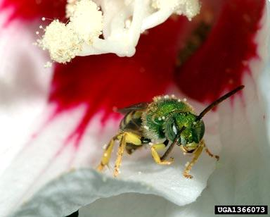
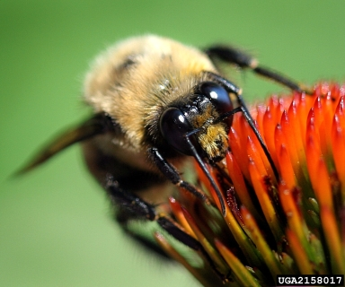
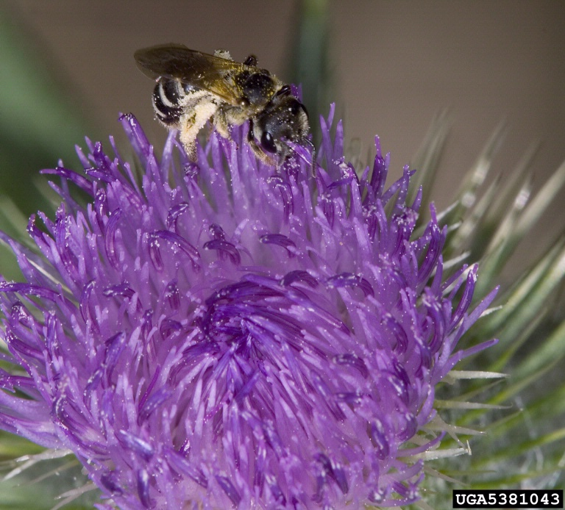
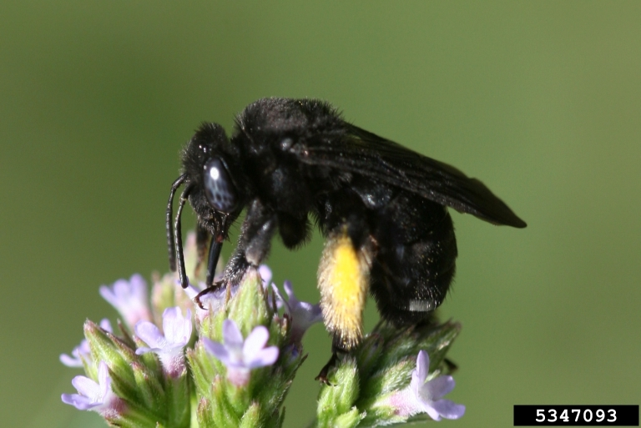
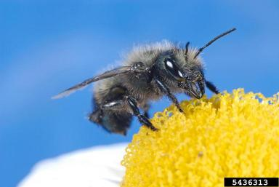
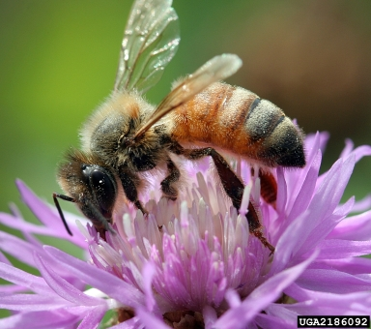
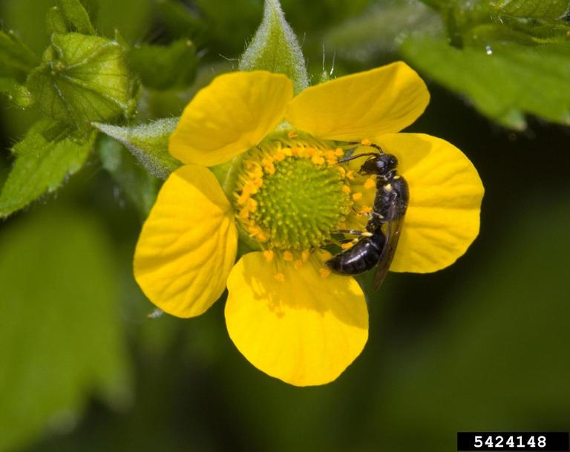




Types of Bees
(and other insect pollinators)
Emily Tenczar &
Vera Krischik
University of Minnesota
Please use the CUES Pollinator Conservation website for information. www.entomology.umn.edu/cues/pollinators/
Look at the section on bees and pesticides for more information. Read the brochure “Pollinator Conservation” to understand the issues and how to mitigate pollinator decline.
Photos from Bugwood.org. Clockwise from top: 1: Susan Ellis; 2-4: David Cappaert, Michigan State University; 5: Joseph Berger; 6: David Cappaert; Center: Johnny N. Dell

Slide 2
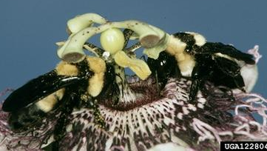
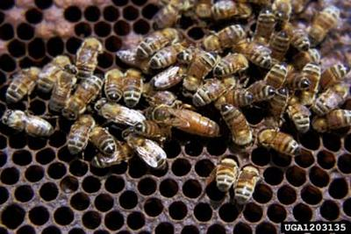
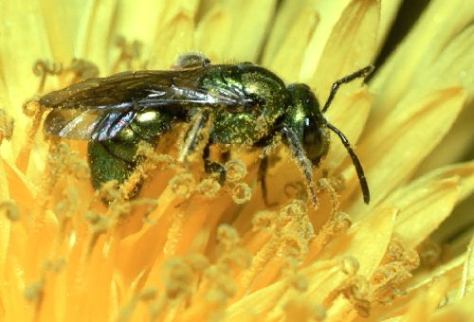
What are bees?
Phylum Arthropoda: segmented body and appendages, chitinous exoskeleton
Class Insecta: protruding mouthparts, wings as adults (usually)
Holometabolous (complete) metamorphosis: egg, larva, pupa, adult
Order Hymenoptera: two pairs of membranous wings in most adults
Jerry A. Payne, USDA ARS, Bugwood.org
Carl Dennis, Auburn University, Bugwood.org
L. West
Photo Researchers, Inc.

Slide 3
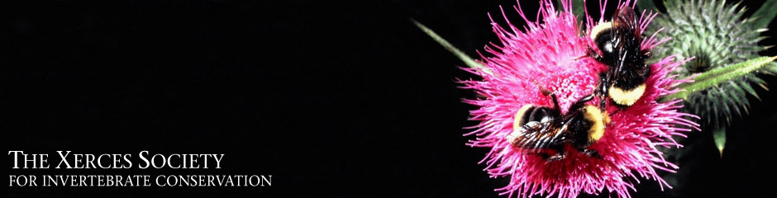
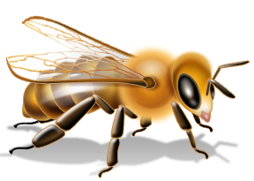
What are bees?
FROM:
Most bees are solitary; honey bees, bumble bees, and some sweat bees are social.
Among the social bees, only honey bee colonies are perennial (survive year to year).
Solitary and social wasps are sometimes mistaken for bees. Social wasps have annual colonies like bumble bees.

Slide 4
What are bees?
FROM:
There is an astonishing diversity of native bees across the USA. About 4,000 species have been identified and catalogued, ranging in length from less than one eighth of an inch to more than one inch. They vary in color from dark brown or black to metallic green or blue, and may have stripes of red, white, orange, or yellow.

Slide 5
Metamorphosis
FROM:
Like a butterfly, a bee changes completely between different life stages (“complete metamorphosis”).
During the first three stages, the bee is inside the brood cell.
The egg resembles a tiny white sausage and lasts from one to three weeks.
Males hatch from unfertilized eggs and females from fertilized eggs.
The larva is the stage when most of the growth occurs, feeding on a food supply left in the cell by the mother.
After the period of rapid growth, the larva changes into a pupa.
When they emerge from the pupal stage, adult bees are fully-grown and ready to feed, mate, and continue the cycle.

Slide 6
Bee Lifestyles
FROM:
Bees can be divided into two groups by their lifestyles: solitary or social.
Social bees share a nest, and divide the work of building the nest, caring for the offspring, and foraging for pollen and nectar. The principal social bees are the honey bee (not native to the U.S.) and the bumble bees (about forty-five species in the U.S.).
In contrast, the vast majority of bees, nearly four thousand species in the U.S., are solitary nesting. They tend to create and provision a nest on their own, without cooperation with other bees. Although they often will nest together in great numbers when a good nesting area is found, the bees are only sharing a good nesting site (like people wanting to live in a beautiful, lakeside location!) and not cooperating.

Slide 7
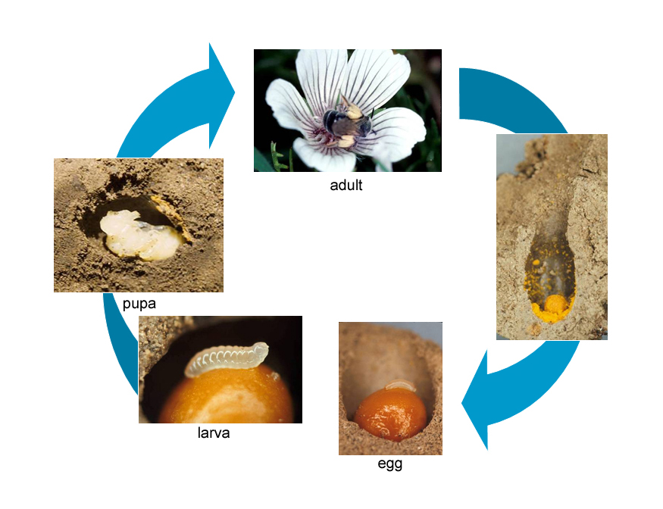
Native solitary bee life cycle
FROM:
The life cycle of a solitary bee consists of four stages: egg, larva, pupa and adult. Solitary adult bees provision their young with a pollen-ball, illustrated above.
All photographs in this illustration are by Dennis Briggs except the photograph of the pupa, which is by Robbin Thorp.

Slide 8
Solitary Bees
FROM:
Solitary bees generally live for a year; the adult stage lasts 3-4 weeks.
The female bee of most species will mate only once.
She then constructs a nest with mud, plant resins, saps, pebbles, empty snail shells, etc. Bees use abandoned beetle burrows or tunnels in snags, or they excavate nests in stems or in the ground.
Each nest has several (1 to 60+) brood cells in which the female lays eggs. Cells are in a single line filling the hole or in complex tunnels.
Before closing the cells, the bee mixes together nectar and pollen to form “bee bread” to place inside each cell. She then lays an egg, usually on the loaf, and caps the cell. When she has completed and capped all cells, she will seal the nest entrance and leave.
After the eggs hatch, each larva feeds on bee bread until becoming a pupa. After an inactive period, it will emerge as an adult.

Slide 9
Solitary Bees
FROM:
Solitary bees collect pollen and nectar to provision brood cells.
Most bees carry nectar in their crop (a sac-like chamber in the digestive tract); how they carry the pollen depends on species.
Most solitary bees have an area of stiff hairs, called a pollen brush or scopa, into which pollen is pushed. The hairs are located either on the underside of the abdomen or along the hind legs.
Solitary bees can be divided into two loose groups according to their foraging habits:
Generalists are bees that gather nectar and pollen from a wide range of flower types and species.
Specialists, on the other hand, rely on a single plant species or a closely related group of plants for nectar and pollen, and are more susceptible to suffer from landscape or habitat changes.

Slide 10
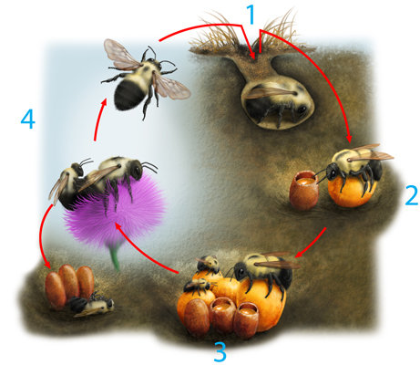
Bumble bee colony life cycle
FROM:
Life cycle of a bumble bee colony.
Illustration by David Wysotski, Allure Illustration.
1. A queen emerges from hibernation in spring and finds a nest site, such as an abandoned rodent burrow.
2. She creates wax pots to hold nectar and pollen, on which she lays and incubates her eggs.
3. When her daughters emerge as adults, they take over foraging and other duties.
4. In autumn the colony produces new queens and male bees, who leave to find mates. Newly mated queens hibernate and the rest of the bees die.

Slide 11
Bumble Bees
FROM:
Bumble bees are the only bees native to the US that are truly social.
Bumble bees live in colonies, share the work, and have multiple, overlapping generations throughout the spring, summer, and fall.
The bumble bee colony is seasonal. At the end of summer only fertilized queens survive to hibernate through winter. In spring, they start new colonies that may grow to several hundred bees or 200 g.
Bumble bees nest in cavities (sometimes in hollow trees or walls, but usually underground, such as abandoned rodent holes).
The queen creates the first brood cells from wax, then provisions them with pollen and nectar and lays eggs. In about a month, they emerge as workers to forage and tend to brood.
The colony grows through summer. At the end of summer, new queens and drones (males) emerge and mate. By fall, most of the bees and the old queen, will die. New, mated queens will overwinter.

Slide 12
Bumble Bees
FROM:
Bumble bees are generalist feeders.
They are often the first bees active in spring and the last in fall. Since they are active for so many months, they must be able to forage on a wide range of plant species.
When foraging, the female bumble bee carries pollen in a concave, hairless area surrounded by stiff hairs on her rear legs, known as the pollen basket or corbicula.
Bumble bees also differ from solitary bees when feeding their larvae. They provide food gradually, adding it to the brood cells as the larvae need it (“progressive provisioning”) rather than leaving all the food in the cell before laying the egg.
Bumble bees store nectar to feed larvae and themselves for a couple of days during bad weather.

Slide 13
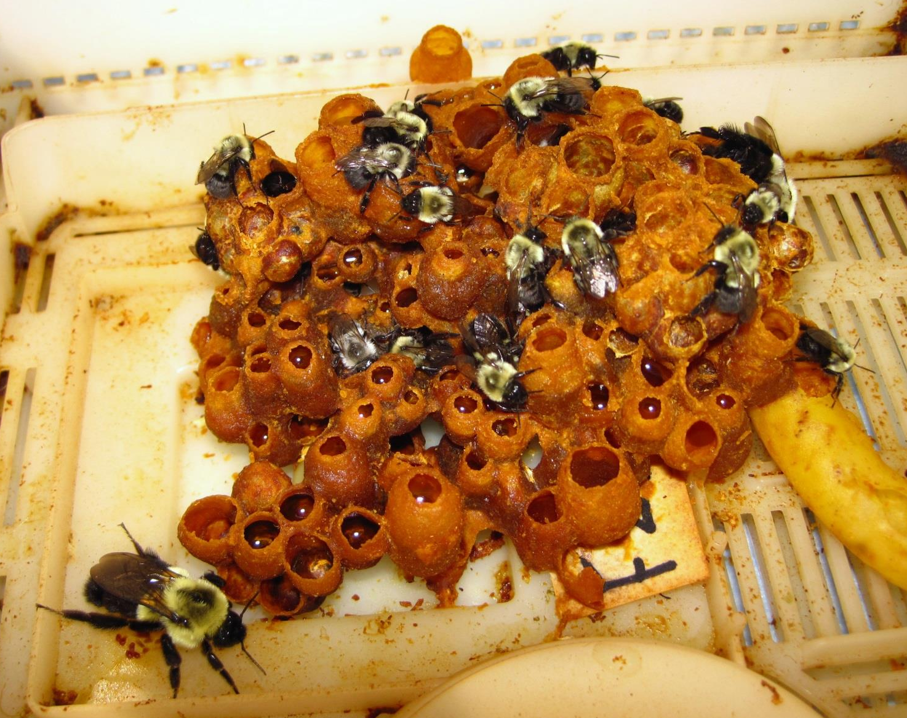
Bumble Bee Colony
Inside a commercial bumble bee colony. Note capped brood cells, shiny “honey pots” full of nectar, and size difference between workers and two large queens (one is newly produced).

Slide 14
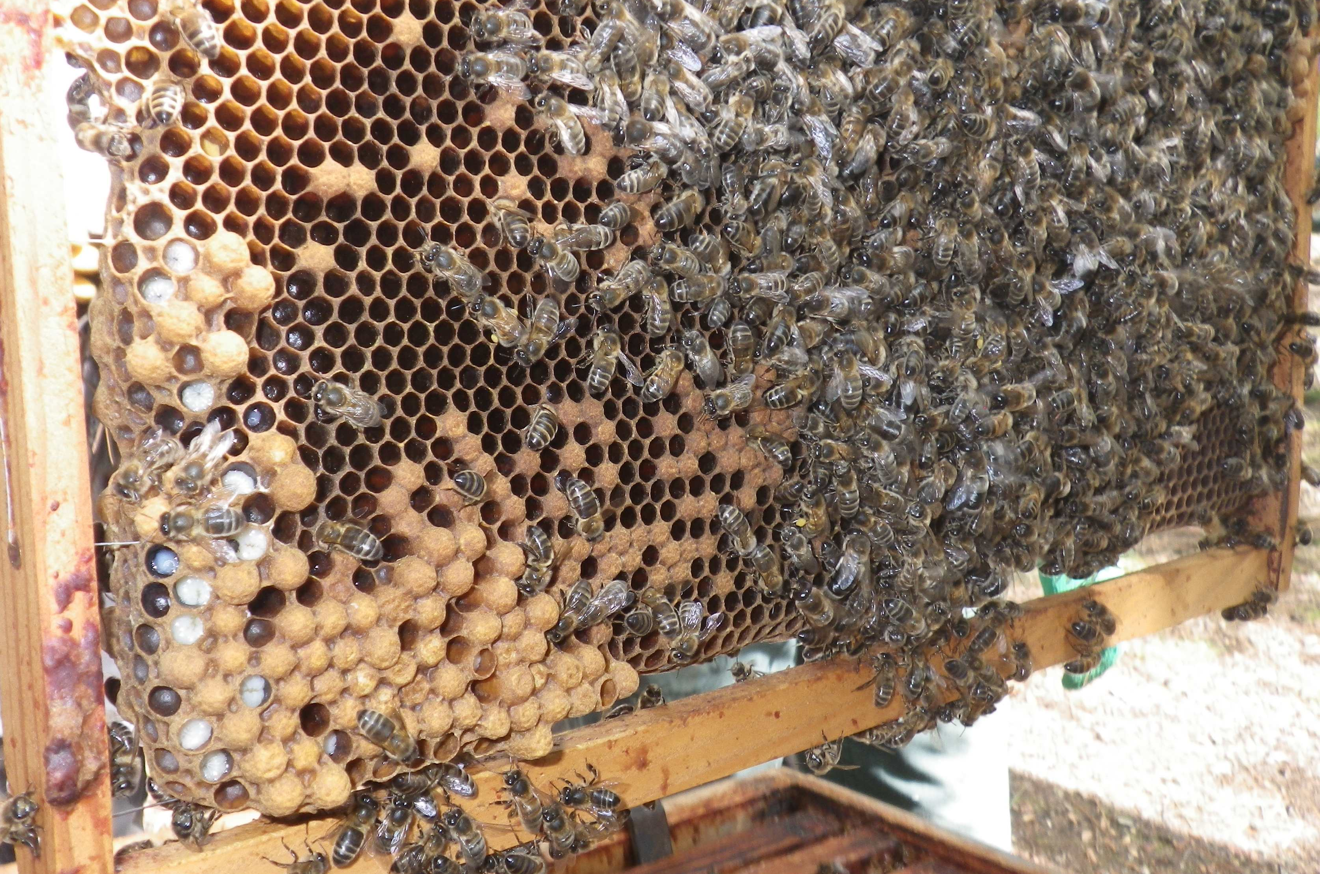
Honey Bee Colony
Inside a honey bee colony. Note capped brood cells containing pupae and open brood cells with larvae (unlike bumble bees, who cap cells immediately after laying eggs).
Photo: Marc Andrighetti (Own work) [CC-BY-SA-3.0 (http://creativecommons.org/licenses/by-sa/3.0)], via Wikimedia Commons

Slide 15
Cuckoo Bees
FROM:
A number of bee species do not make their own nest and, instead, lay their eggs in cells prepared by another species of bee.
Cuckoo bees are not true parasites as they do not feed on the host bee (but they do kill the larva in the cell so they can get all the food). They are called cleptoparasites, as they grow from egg to adult by feeding on provisions stolen from the host species.
Typically, cuckoo bees that prey on solitary bees enter the nest to lay eggs while the host is out foraging.
Cleptoparasites of bumble bees enter an established colony full of workers. They either fight to the death with the existing queen or they hide in the nest until they take on the same smell as the host colony. Once accepted by the colony, the cuckoo bumble bee will take over queen’s role, laying eggs which the workers tend.

Slide 16
Do all bees sting?
FROM:
Most bees usually do not sting.
Only the bees that live in a colony or hive (“social
bees,” i.e., honey bees and bumble bees) are likely
to sting because they have a colony to defend.
Most native social bees do not defend their hive aggressively.
When foraging away from the nest, no bee is looking for conflict and will only sting as a last resort–perhaps as a result of being swatted or accidentally being caught in someone’s clothes.
You are likely to have more problems from the yellowjackets attracted to soda cans or garbage than you will from native bees.

Slide 17
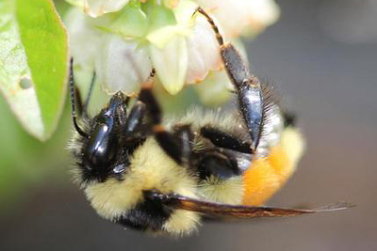
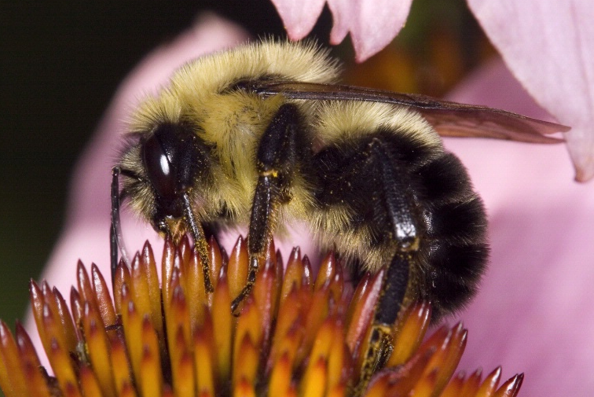
Bumble Bees (Bombus spp.)
Order Hymenoptera
Family Apidae
These large (10 to 23 mm), hairy bees are the only truly social bees native to the United States.
Colonies are annual. Fecundated queens emerge in spring and begin colonies in the ground. Males and queens are produced in fall. New queens mate with unrelated males before overwintering in the ground.
Bumble bees are used to pollinate greenhouse crops such as tomato. Pollen is carried on the hind legs on corbiculae (enlarged areas surrounded by stiff hairs).
A few species invade nests of other bumble bees; these “cleptoparasites” do not collect pollen.
Red-tailed bumble bee (Bombus ternarius)
Rob Routledge, Sault College, Bugwood.org
Common eastern bumble bee (B. impatiens)
David Cappaert, Michigan State University, Bugwood.org

Slide 18
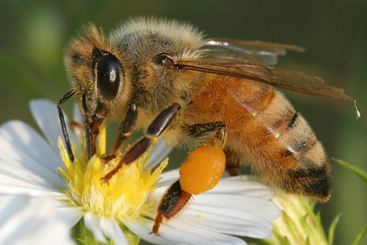
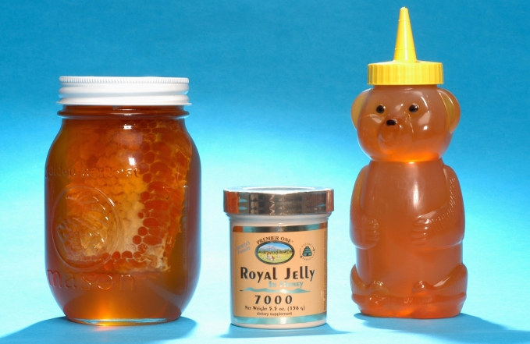
Honey Bees (Apis mellifera)
Order Hymenoptera
Family Apidae
Honey bees (native to Europe) are used for pollination (almonds, for example) and for honey, beeswax, and propolis production. They are 10 to 15 mm in length and possess corbiculae like bumble bees.
Honey bee colonies are perennial. New colonies form when an old queen swarms with a group of workers. The queen mates with unrelated males. Fertilized eggs become workers; males (unfertilized eggs) are produced prior to swarming. Feral honey bees nest in trees or other cavities.
Honey bees are usually docile. An African subspecies (A. mellifera scutellata), present in the south, can be aggressive.
Honey bee (Apis mellifera)
David Cappaert, Michigan State University, Bugwood.org
Honey bee products. Different types of honey (clover, buckwheat, orange, etc.) are produced when honey bees forage on specific crops.
Jeffrey W. Lotz, Florida Dept. of Agriculture & Consumer Services, Bugwood.org

Slide 19
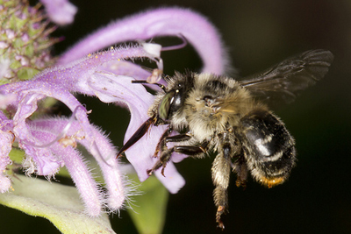
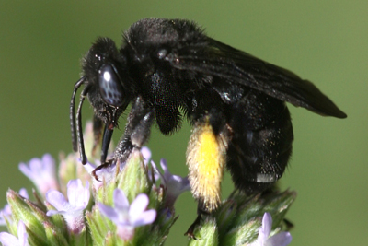
Digger and Long-Horned Bees
Order Hymenoptera
Family Apidae
These bees are sometimes classified in family Anthophoridae along with carpenter bees. These hairy bees are 5 to 25 mm in length and use scopae (stiff hairs) instead of corbiculae to carry pollen on the hind legs.
Most species nest in the ground or in vertical banks, often in sandy soil. Some waterproof their brood cells with secreted waxy or oily material.
Digger and long-horned bees are usually solitary; however, some species aggregate or use common entrances to nesting areas. Each female cares for her own brood.
Digger bee (Anthophora terminalis)
Laura Gooch, Creative Commons Copyright,
http://www.flickr.com/photos/lgooch/7705996856/
Long-horned bee (Melissodes bimaculata)
Johnny N. Dell, Bugwood.org

Slide 20
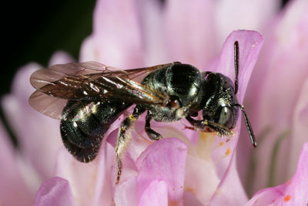
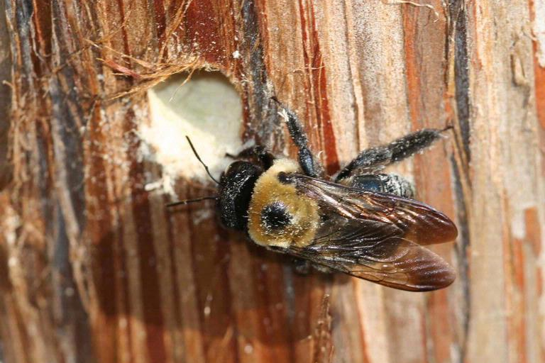
Carpenter Bees
Order Hymenoptera
Family Apidae
Large carpenter bees (Xylocopa spp.) are 13 to 30 mm in length and small carpenter bees (Ceratina spp.) are 3 to 15 mm. Scopae are located on the hind legs.
In spring, females make or use existing tunnels to lay eggs and insert pollen and nectar. There may be several generations per year. Adults overwinter in the nests.
Xylocopa species chew nests in wood (including buildings!) and stems of plants. Ceratina species have smaller jaws and utilize softer material, such as dead wood.
Most species are solitary, but a few species are semisocial (mothers and daughters share nests).
Small carpenter bee (Ceratina sp.)
Steve Nanz, University of Minnesota Extension Gardening Info
Large carpenter bee (Xylocopa virginica)
Johnny N. Dell, Bugwood.org

Slide 21
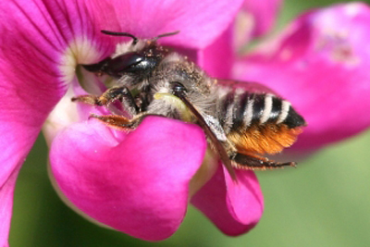
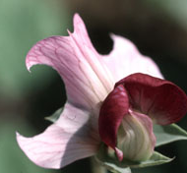
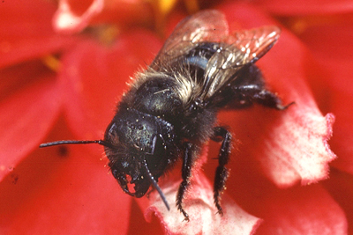
Leafcutter & Mason Bees
Order Hymenoptera
Family Megachilidae
These solitary bees range from 3 to 20 mm. Females collect pollen on scopae on the underside of the abdomen.
Females usually nest in cavities (crevices, beetle tunnels in dead trees, etc.), where they deposit eggs and provision cells with pollen and nectar before sealing each cell. Larvae feed and develop in the cells.
Leafcutter bees (Megachile spp.) cut sections of leaves and flowers to line brood cells, while mason bees (Osmia spp.) use mud. Other species use pebbles, wood, plant hairs, or other materials.
The blue orchard bee (Osmia lignaria) is an important pome fruit pollinator.
Leafcutter bee (Megachile sp.) and damage (inset)
Whitney Cranshaw, Colorado State University, Bugwood.org
Blue orchard bee (Osmia lignaria)
Scott Bauer, USDA Agricultural Research Service, Bugwood.org

Slide 22
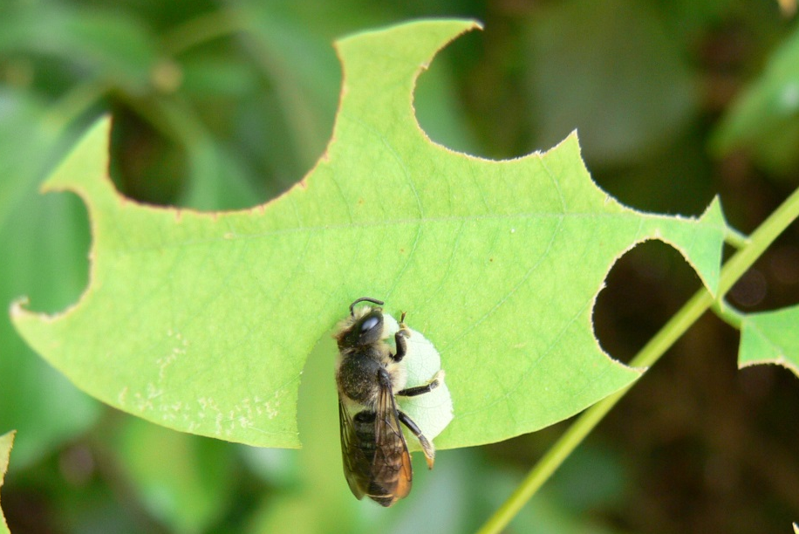
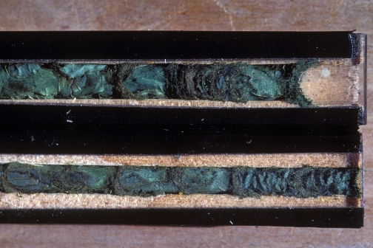
Leafcutter Bees
Most species nest in above-ground cavities (beetle tunnels in snags, crevices in rocks, etc.) but a few species nest in the ground.
The female cuts pieces of leaves and flower petals to line and divide cells in the nest.
Like other solitary bees, she provisions each cell with nectar and pollen before laying an egg and sealing the cell.
After feeding, the offspring overwinter in the cells as prepupae (mature larvae) or new adults.
Damage caused by adult female leafcutter bees is aesthetic and does not cause significant plant injury.
Leafcutter bee (Megachile rotundata)
Jodelet / Lépinay (Own work) [CC-BY-SA-2.0-fr (http://creativecommons.org/licenses/by-sa/2.0/fr/deed.en)], via Wikimedia Commons
Pupae in cells
Howard Ensign Evans, Colorado State University, Bugwood.org

Slide 23
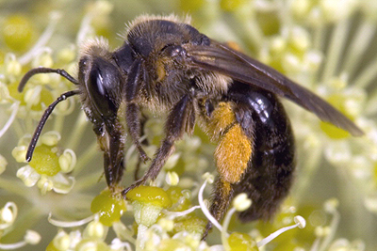
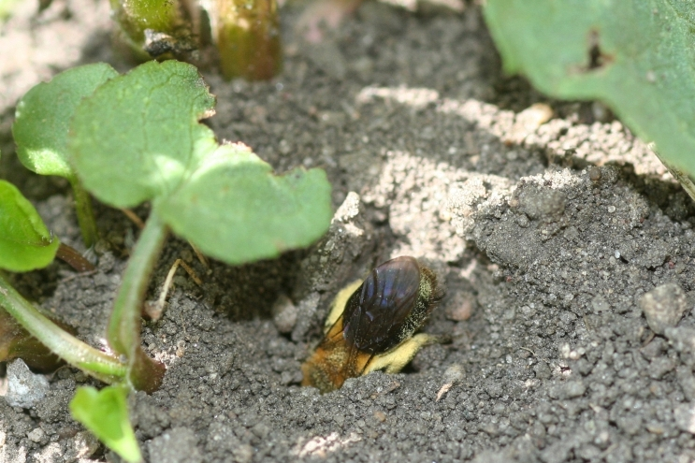
Mining Bees
Order Hymenoptera
Family Apidae
These mostly solitary bees can be as small as 2 mm or as large as 25 mm. Scopae are located on the hind legs. Some species have additional hairs on the thorax.
All species nest in the ground, especially on slopes, where large numbers of bees may aggregate.
Mining bees are common in the early spring. Some species are important apple pollinators and can move more pollen than honey bees can!
Mining bee
David Cappaert, Michigan State University, Bugwood.org
Andrena sp. female digging burrow
Whitney Cranshaw, Colorado State University, Bugwood.org

Slide 24
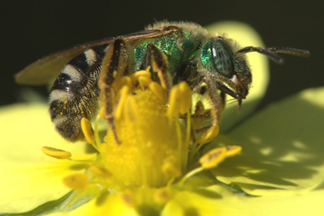
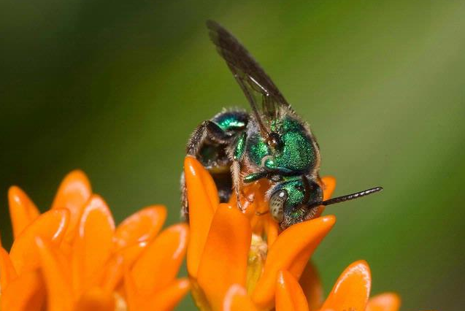
Sweat Bees
Order Hymenoptera
Family Halictidae
These small bees are sometimes brightly colored and metallic. Size ranges from 3 to 23 mm depending on species. Most species have scopae on the hind legs.
Most sweat bees are solitary and nest in the ground or in wood, but some Lasioglossum species exhibit social behavior. Some Sphecodes species are cleptoparasites (nest in other bees' nests). The cleptoparasitic species do not collect pollen on scopae. Colonies are annual.
Green sweat bee (Agapostemon sp.)
David Cappaert, Michigan State University, Bugwood.org
Sweat bee
Susan Ellis, Bugwood.org

Slide 25
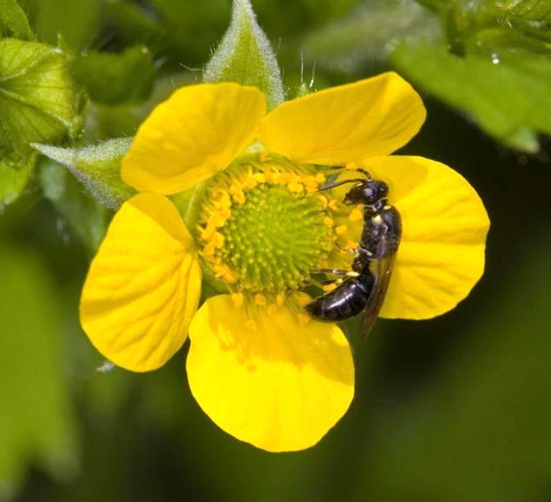
Cellophane Bees
Order Hymenoptera Family Colletidae
These 5 to 15 mm solitary bees nest in the ground or in wood and line the insides of the cells with a substance that resembles cellophane.
Colletus and Hylaeus are two common genera. Colletus carry pollen on scopae on the hind legs, but Hylaeus store pollen in the crop (part of the digestive system).
Although solitary in nesting behavior, they may aggregate.
Yellow-faced bee (Hylaeus sp.)
David Cappaert, Michigan State University, Bugwood.org

Slide 26
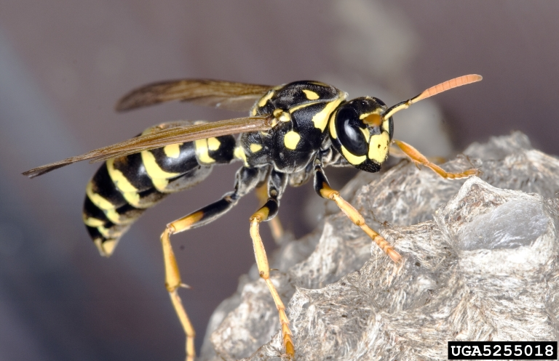
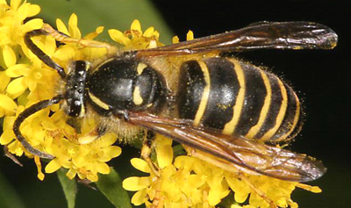
BEE LOOKALIKES
Social & Potter Wasps
Order Hymenoptera
Family Vespidae
Wasps may be confused with bees but are usually less hairy and have more restricted abdomens.
Yellowjackets, hornets, and paper wasps are large (up to 25 mm) social wasps that nest in cavities, trees, and eaves of buildings. Yellowjackets usually nest in the ground and often sting if disturbed. These wasps also invite themselves to late summer picnics. Colonies are annual.
Potter wasps are solitary vespids that construct nests with mud or utilize cavities or ground tunnels. Vespids are beneficial predators that hunt other insects to feed to their larvae.
Paper wasp (Polistes dominula)
David Cappaert, Michigan State University, Bugwood.org
Eastern yellowjacket (Vespula maculifrons)
Gary Alpert, Harvard University, Bugwood.org

Slide 27
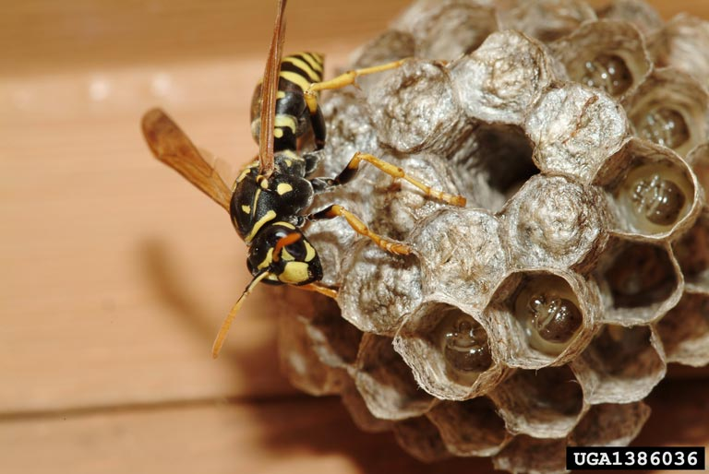
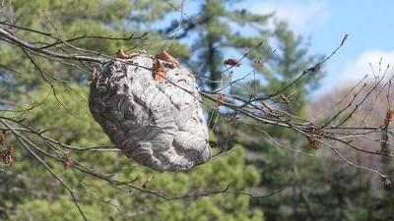
BEE LOOKALIKES
Social Wasps
The life cycle of social wasps is similar to that of bumble bees, except that wasps are mainly carnivorous.
Among the social wasps, the hornets, aerial yellowjackets, and paper wasps are the species usually found above ground, while most yellowjackets nest in the ground or in cavities . Females chew on wood to make into papery brood cells. Workers hunt caterpillars and other insects to feed the developing larvae.
In fall, drones and queens are produced and mate. The newly fertilized queens overwinter and begin the cycle again in the spring. Colonies do not reused nests.
Paper wasps (like this Polistes dominula) make open nests; note larvae present in brood cells
Joseph Berger, Bugwood.org
Baldfaced hornets (Dolichovespula maculata) make enclosed nests
Steven Katovich, USDA Forest Service, Bugwood.org

Slide 28
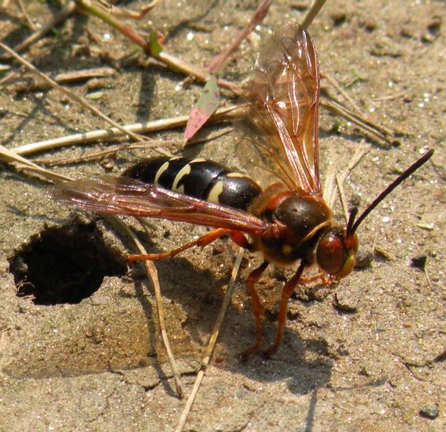
BEE LOOKALIKES
Solitary Wasps:
Mud-Daubers, Sand, & Digger Wasps
Order Hymenoptera
Family Sphecidae
Spider Wasps
Order Hymenoptera
Family Pompilidae
Solitary wasps nest in the ground or in cavities and provision nest cells with paralyzed insects or spiders. Larvae feed on the paralyzed prey.
One familiar species is the cicada killer (Sphecius speciosus), which hunts cicadas. Mud-daubers use mud to construct brood cells and can be found alongside buildings. Solitary wasps usually don’t sting humans.
There are also several other families of wasps that are found on flowers.
Cicada killer (Sphecius speciosus)
Jessica Lawrence, Eurofins Agroscience Services, Bugwood.org

Slide 29
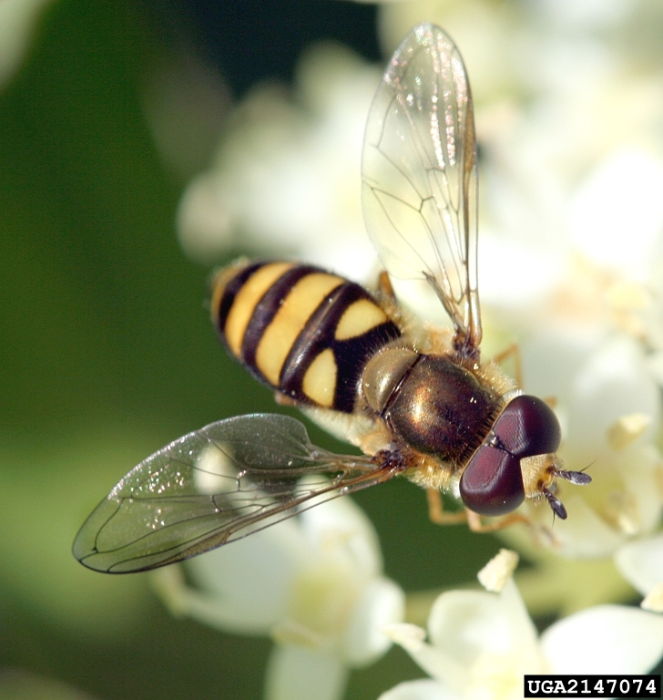
BEE LOOKALIKES
Flies
Order Diptera
Family Syrphidae & others
Many flies feed on nectar as adults. Some mimic bees, flies have only two wings, whereas bees and wasps have four. The huge eyes and clubbed antennae in many species are also giveaways.
Syrphid flies (also called flower or hover flies) are familiar bee mimics. Most syrphid larvae are predators of aphids and other small insects.
Flies are passive pollinators; they do not actively collect pollen, but pollen becomes trapped on their bristles while feeding.
Syrphid fly (family Syrphidae)
David Cappaert, Michigan State University, Bugwood.org

Slide 30
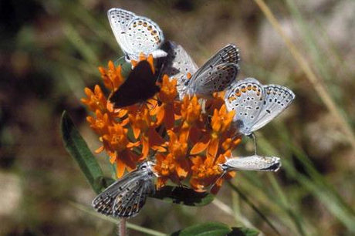
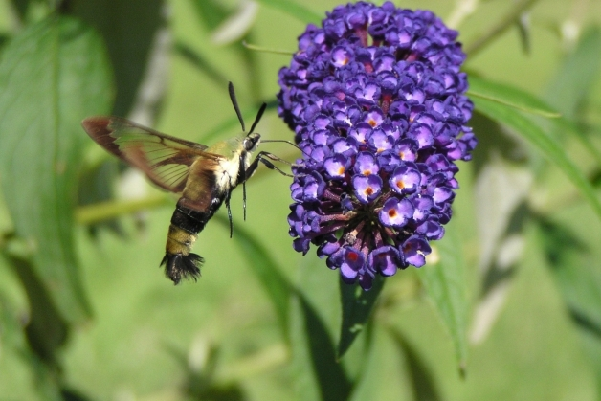
Butterflies & Moths
Order Lepidoptera
Many families
All butterflies and some moths feed on nectar as adults. Like flies, these insects do not directly collect pollen, but hairs and scales pick up pollen during feeding.
Most larvae of butterflies and moths feed on plants. Tolerating some feeding damage in the garden will allow desirable species to develop into adults. Visit www.butterfliesandmoths.org or bugguide.net for identification tips.
Karner blue butterfly (Plebejus melissa)
Catherine Herms, The Ohio State University, Bugwood.org
Hummingbird clearwing (Hemaris thysbe)
Alan Grant, Dept Environmental Protection, Bugwood.org

Slide 31
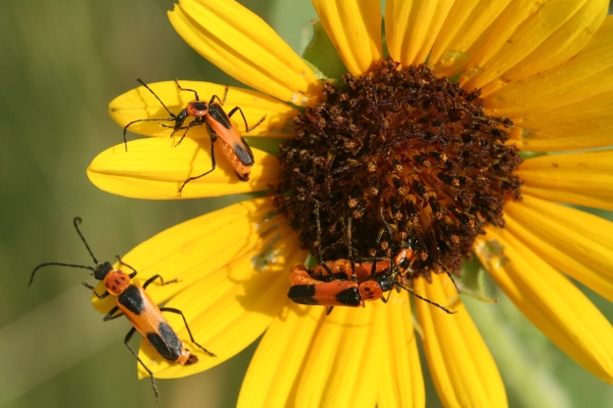
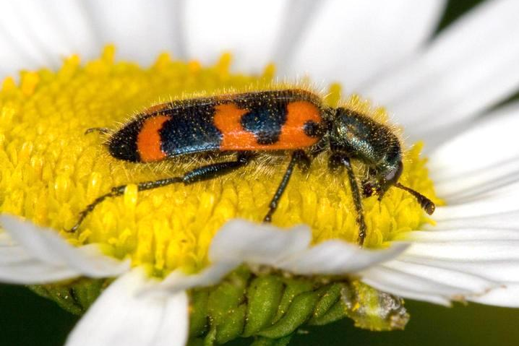
Beetles
Order Coleoptera
Many families
There are more beetles that any other type of animal. Their diets range from plants to decaying materials to other insects. Some beetles feed in similar habitats as both larvae and adults; others do not.
Many beetles can be found visiting flowers as passive pollinators. Some flowers have evolved odors to attract beetles
Goldenrod solider beetle
(Chauliognathus pensylvanicus)
Whitney Cranshaw, Colorado State University, Bugwood.org
Checkered beetle (Trichodes nutalli)
David Cappaert, Michigan State University, Bugwood.org

Slide 32
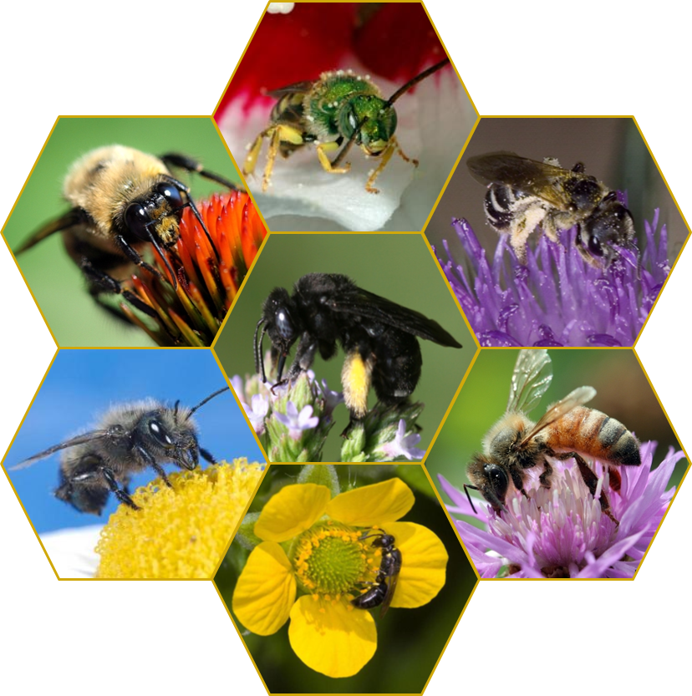
THE END
CUES Pollinator Conservation Page: http://www.entomology.umn.edu/cues/pollinators/
University of Minnesota Bee Lab:
http://www.beelab.umn.edu/
University of Minnesota Department of Entomology: http://www.entomology.umn.edu/
University of Minnesota Extension Service:
http://www.extension.umn.edu/
The Xerces Society for Invertebrate Conservation: http://www.xerces.org/

